Slide 1
PP5: Inheritance and genetics
Year 10 Science

Slide 2
What influences you?
Two influences make you what you are at this moment: heredity and environment.
Heredity is the set of characteristics that you inherited from your parents.
Environment is the set of factors that have acted on you throughout your life.
Sometimes it is difficult to determine where the influences of heredity end and environmental influences begin.
Genetics is the study of heredity and attempts to provide some answers to this question.

Slide 3
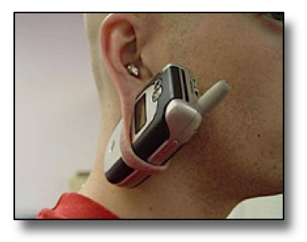
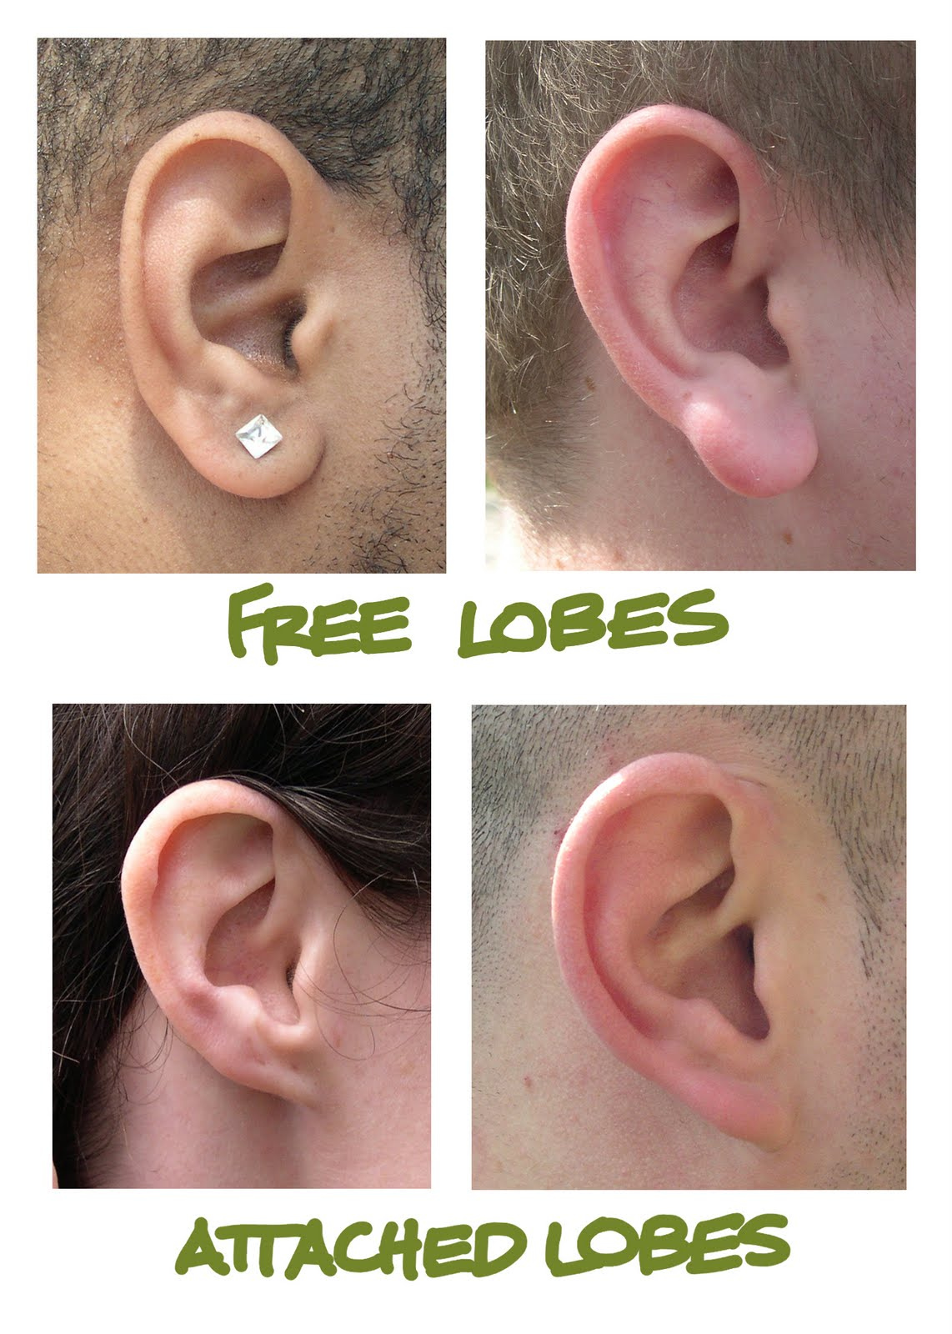
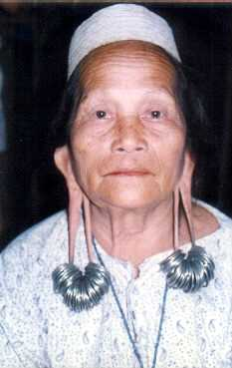

Slide 4
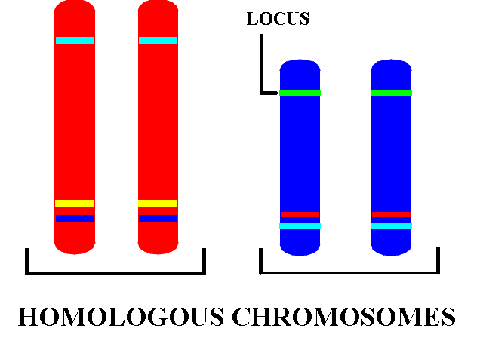
Genes and heredity
A gene is a small length of DNA that codes for a particular characteristic
Eg Eye color, hair color, freckles, nose shape
A gene will always have the same location (called the locus) on a given chromosome
As chromosomes exist in pairs, the genes too exist in pairs – one each from mum and dad
The matching pairs of chromosomes are called homologous chromosomes

Slide 5
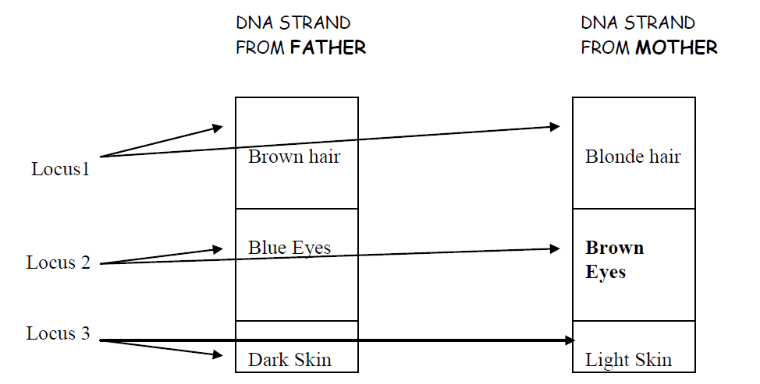

Slide 6
Alleles
Note that there are alternatives in characteristics, (Eg: Blue/brown eyes)
These alternatives are called alleles
One allele comes from the mother and the other from the father
The child may have two of the same, or two different alleles
What the child will look like will depend on what combination of alleles he/she inherits

Slide 7
Both the same, or one of each
If a person carries two of the same alleles Eg Blue eyes/Blue eyes, they are said to be homozygous for that trait
If a person carries one of each type of allele for a particular trait Eg Blue eyes/Brown eyes, they are said to be heterozygous for that trait

Slide 8
Gene example
There is a gene for tongue rolling
The two alleles are; T t (tongue rolling) (non-tongue rolling)

Slide 9
Genotype
Genotype - The actual genes we have Example: TT (two genes for tongue rolling)

Slide 10
Phenotype
Phenotype – The genetic trait that we observe Example: Tongue roller

Slide 11
Dominant & Recessive
Most gene pairs exist with one of the pair dominant over the other. If present, it determines the phenotype.
The allele that is dominated over is called the recessive gene Eg: Genotype Tt
Tongue rolling (T) is dominant over non-tongue rolling (t)
Phenotype is a tongue roller.

Slide 12
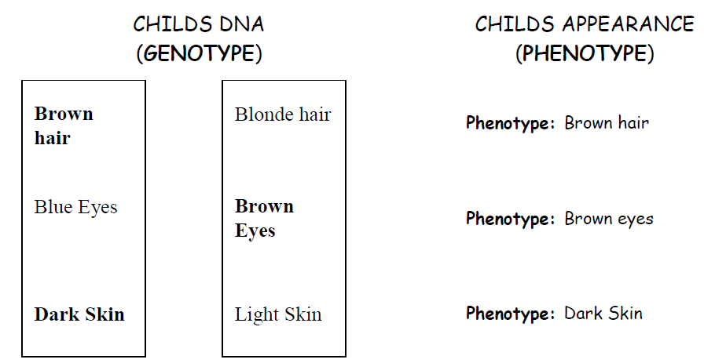
Note: The dominant allele is in bold

Slide 13
Genetic outcomes
We know one gene of a pair comes from father and the other comes from mother Example: TT x tt (father) (mother) ↓ Tt (child)

Slide 14
Letters to show alleles
Use code letters for alleles
Any letter can be used, but the same letter to show alleles of the one trait
Use the capital letter to show which is the dominant allele D = dark hair gene d = light hair gene

Slide 15
Genotype
Three possible genotypes
DD
Dd
dd

Slide 16
Phenotype
If we ignore the environment . . .
Two possible phenotypes
DD = Dark hair
Dd = Dark hair
dd = Light hair

Slide 17
Phenotype
If we ignore the environment . . .
Two possible phenotypes
DD = Dark hair
Dd = Dark hair
dd = Light hair
D (Dark hair) is dominant
d (Light hair) is recessive

Slide 18
In practice . . .

Slide 19
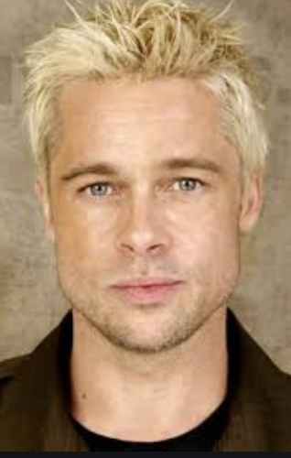
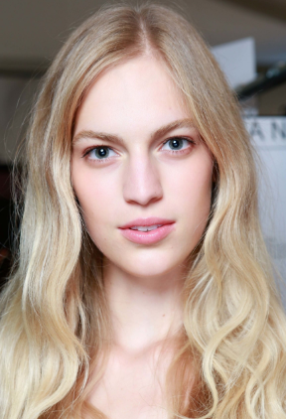

Slide 20
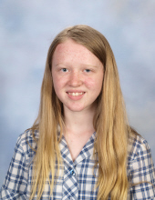
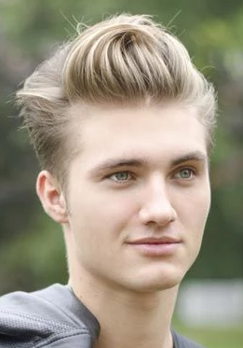
dd
dd
dd

Slide 21
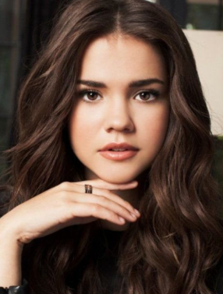
D?
dd

Slide 22
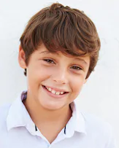
D?
dd
Dd

Slide 23
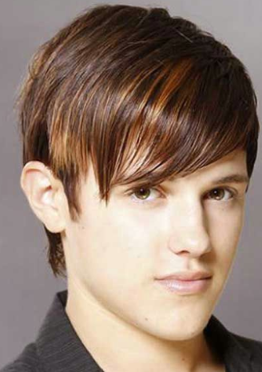
D?
dd
Dd
Dd

Slide 24
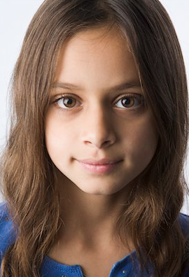
D?
dd
Dd
Dd
Dd

Slide 25
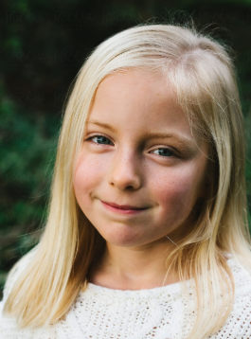
Dd
dd
Dd
Dd
Dd
dd
d

Slide 26
Tongue rolling
Tongue rolling is dominant
Non-tongue rolling is recessive
Choose a pair of letters to represent the alleles (capital letter denotes the dominant trait)
T for tongue rolling and
t for non tongue rolling
Lets investigate the genetic possibilities

Slide 27
Possible outcomes
TT x TT ↓

Slide 28
Possible outcomes
TT x TT ↓ TT
100% Tongue rollers

Slide 29
Possible outcomes
TT x tt ↓

Slide 30
Possible outcomes
TT x tt ↓ Tt
100% tongue rollers

Slide 31
Possible outcomes
tt x tt ↓

Slide 32
Possible outcomes
tt x tt ↓ tt
100% NON tongue rollers

Slide 33
Possible outcomes
Tt x Tt ↓

Slide 34
Possible outcomes
Tt x Tt ↓
We can use a punnet square to work it out
 | T | t
T
t

Slide 35
Possible outcomes
Tt x Tt ↓
 | T | t
T | TT
t

Slide 36
Possible outcomes
Tt x Tt ↓
 | T | t
T | TT | Tt
t

Slide 37
Possible outcomes
Tt x Tt ↓
 | T | t
T | TT | Tt
t | Tt

Slide 38
Possible outcomes
Tt x Tt ↓
 | T | t
T | TT | Tt
t | Tt | tt

Slide 39
Possible outcomes
Tt x Tt ↓ TT, Tt, Tt, tt
 | T | t
T | TT | Tt
t | Tt | tt

Slide 40
Possible outcomes
Tt x Tt ↓ TT, Tt, Tt, tt
TT Tt tt 1 : 2 : 1
 | T | t
T | TT | Tt
t | Tt | tt

Slide 41
Possible outcomes
Tt x Tt ↓ TT, Tt, Tt, tt
TT Tt tt
1 : 2 : 1
25%: 50%: 25%
 | T | t
T | TT | Tt
t | Tt | tt

Slide 42
Possible outcomes
Tt x Tt ↓ TT, Tt, Tt, tt
TT Tt tt = Tongue rollers non rollers 1 : 2 : 1 3 : 1
25%: 50%: 25% 75% : 25%
 | T | t
T | TT | Tt
t | Tt | tt

Slide 43

Key Terms
Copy the definitions from the power point for the following terms in your books
Allele
Homozygous
Heterozygous
Genotype
Phenotype
Dominant
Recessive

Slide 44
Activity
Worksheet “Bikini Bottom Genetics”

Slide 45
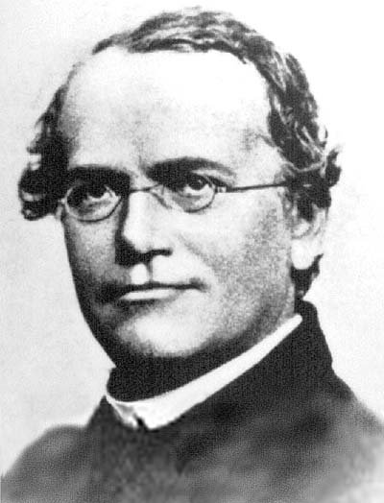
The Monk and his peas
Who is this dude?
Gregor Mendel. He is the father of genetics
An Austrian monk who had way too much time in his monastery and grew thousands and thousands of pea plants
He found that they had a large amount of variation in their appearance, and sought to find out why.
His findings are still accepted as the basis of genetics today

Slide 46
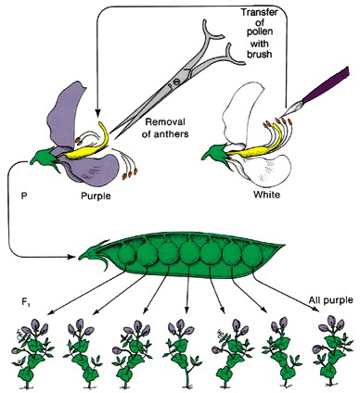
Mendel and his peas
In one of his experiments he took the anthers off a purple flower. Why?
To stop it self fertilizing!
He then took pollen from a white flower and fertilized the purple flower.
He found that 100% of the offspring were purple.
He then took two of the purple offspring and crossed them. What do you think he found?

Slide 47
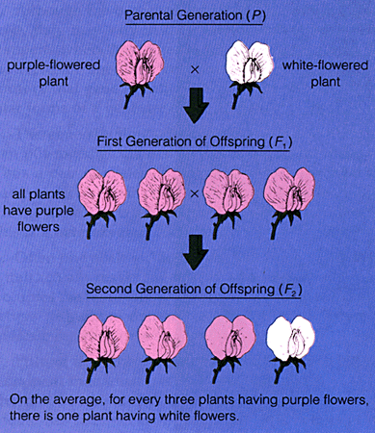
The pea experiment
Mendel had no answer for this. No one had studied inheritance this closely before.
He deduced that:
Each parent contributes a piece of information to the offspring.
Some information was “dominant” to the other.
Which bits of information the offspring got from it’s parent was controlled by random chance.

Slide 48
Explanation
First cross Purple x White
Second cross Purple x Purple
 | H | H
h | Hh | Hh
h | Hh | Hh
 | H | h
H | HH | Hh
h | Hh | hh
Genotype ratio
100% Hh
Phenotype ratio
100% purple
Genotype ratio
HH : Hh : hh
1 : 2 : 1
Phenotype ratio
Purple : White
3 : 1

